Slide 1
The Neurodiversity Model at St Peter’s
30/4/2024

Slide 2
What is Neurodiversity?
“Potentially up to 30-40% of the world could be classified as neurodivergent and sit outside the neurotypical way of learning and processing.” Alix,S (2024,p6)

Slide 3
Labels that are used:
Attachment disorder, ADHD, Auditory processing disorder, Autism, DLD, Dyscalculia, Dyslexia, Dyspraxia, Foetal alcohol spectrum disorder, General anxiety disorder, Oppositional defiance disorder, OCD, Pathological demand avoidance, post-traumatic stress disorder, Rejection sensitive disorder, Sensory processing disorder, Tourette syndrome.

Slide 4
Models – main ways of thinking about difference
Medical model –implies that anyone who processes information differently has something wrong with them (deficit).
Social model – outlines a collective responsibility by society to support and address any difficulties that have been created as a result of how a society is formed.
Biopsychosocial model – based on a combination of biological, psychological and social factors and their complex interactions.
Neurodiversity model-it does not believe that there is a right or wrong way to function, for cognitive processing, they are just different for different learners…

Slide 5
Variation in a species
Slorach (2016) argues that these differences in cognitive functioning are part of natural human variation. It is normal to have variation in a species.

Slide 6


Does A Calla Lily Have Petal Deficit Disorder?

Slide 7

Neurodiversity model
Difference is not a disability in itself but it is the way in which the social context, the environment and the interactions that have all been formed and valued by a neurotypical society are what cause discrimination.
Instead of thinking of ‘disorders’ or ‘impairments’ we need to make a shift in our own thinking and understanding to know that different processing is normal, natural and ok.

Slide 8
Supporting the Neurodiversity model at St Peter’s
Celebrating and understanding of difference through focus weeks/days, assemblies, PSHE scheme, throughout our Inclusive curriculum.
Universal whole school strategies: Zones of Regulation and Level up! Our Behaviour policy and our Emotion coaching approach, our growth mindset approach/normalising failure
Adaptations and accommodations: e.g. noise cancelling headphones, class movement breaks…
Highlight and work with pupils’ strengths and interests.

Slide 9
Focusing on difference rather than deficit
Is promoting a model of acceptance in which all differences are respected and celebrated. This in turn enhances pupils’ self esteem and well-being.

Slide 10
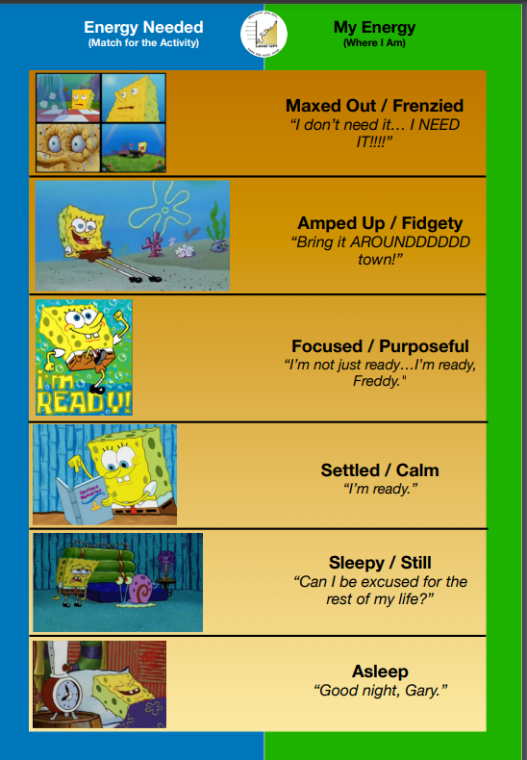
Level up! Thinking more about energy levels than feelings
https://www.autismlevelup.com/#tools

Slide 11
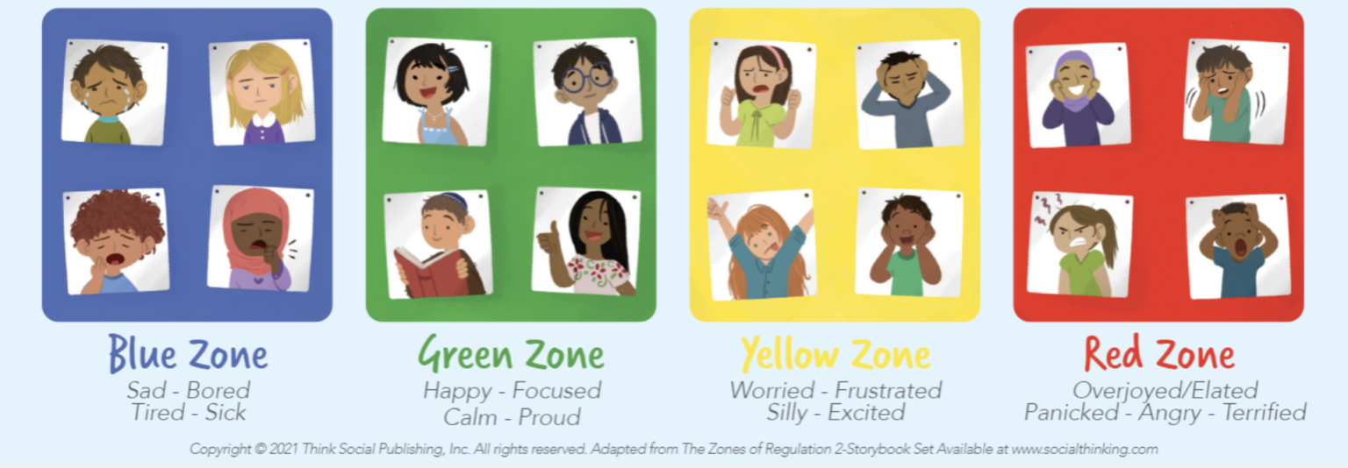
Zones of Regulation
https://zonesofregulation.com/

