Slide 1
Emotion coaching
24/9/24

Slide 2
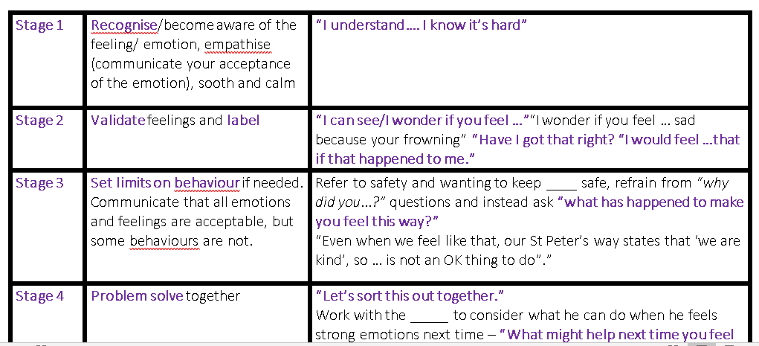

Slide 3
What is Emotion Coaching?
Based on research by American Psychologist John Gottman, Emotion Coaching uses moments of heightened emotion and resulting behaviour to guide and teach the child and young person about more effective responses.
Through empathetic engagement the child's emotional state is verbally acknowledged and validated, promoting a sense of security and feeling 'felt'. This activates changes in the child's neurological system and allows the child to calm down, physiologically and psychologically.
When the child is calmer, incidents are discussed in a more rational and productive manner. Moves are made to problem solve and engage in solution-focused strategies.

Slide 4
Philosophy behind approach…
We are all born with an ability to feel and have feelings.
We are NOT born with the coping strategies to manage big feelings.
We need opportunities to experience that emotion and learn how to cope with the emotion with the support of someone we trust.
All behaviour is a form of communication- be curious about the feelings behind the behaviours.

Slide 5
Emotional Styles
Videos of different styles to manage behaviours, including our preferred Emotion Coaching method:
https://www.emotioncoachinguk.com/resources-for-professionals-parents-carers
Emotional styles we use to respond to emotions in others: emotion disapproving, emotion dismissing, laissez-faire, and emotion coaching.

Slide 6
Stage 1- tune in and empathise
Observe and tune in to what the behaviour is communicating- be curious about the feelings behind the behaviour.
Empathise with that emotion, think back to when we have experienced that emotion.
Notes:
Step One: Recognising the child’s feelings and empathising with them. This first step does not require physical action, but is the internal recognition and acknowledgement of the adult that the child is experiencing an emotional moment. It allows the necessary pause for thought and is important because it gives the adult the time to bear witness to the child’s emotions, tune into their own emotional response to the situation and their empathy to get ready to manage step two. Look for physical and verbal signs of the emotion being felt

Slide 7
Stage 2 – Label, normalise, validate the emotion
“I wonder”… Wonder out loud- comment on the behaviours we see and what emotions they may be feeling
Help the child think about body sensations and cues.
Normalise
Non judgemental
Validating the emotional experience
What can we do to feel calm? (draw, hug, walk together…)
Notes:
It is the labelling of the emotion that soothes the child’s mind and body.
The research tells us that just by naming the emotion the other person is feeling, we are encouraging the regulatory processes to engage and reconnect the thinking brain with the limbic system. By being with the person as they are experiencing a heightened state and through naming that emotion, we are communicating that firstly we understand how they are feeling and secondly that is ok to feel like that. This explicitness is a vital step and without it, effective Emotion Coaching cannot happen.

Slide 8
Stage 2 – example script
‘I can see you’re frowning and you’re kicking the wall. You are expressing a lot of energy. I wonder if you are feeling angry?. I would feel angry if that happened to me. It’s ok to feel angry’
‘I noticed you looking around at the others who are working on their projects. I think you might be feeling nervous right now about your work. Have I got that right?’

Slide 9
Feeling calm examples
“Let’s take a break, take a break, sit down and pause for a minute”
It’s ok to sit with an emotion, describing how it is feeling.
Give examples, “ when I feel that upset, I feel like I can’t catch my breath, so I try to breathe slowly. Sometimes I feel a little embarrassed too and a little hurt. I feel like my heart is a bit bruised. After a few minutes, I feel like my heart feels better and I can go on with my day.”
“It doesn’t seem like I am helping. You remember what to do when you are upset and how to calm down. I’ll be over here when you need me.”

Slide 10


Stage 2 – Emotional Literacy
No good or bad feelings just pleasant and unpleasant
Feelings are like waves in the ocean- they can crash in unexpectedly or gently roll in. You can’t stop these waves but notice them, be aware, so they don’t knock you off your feet!

Slide 11
Stage 3 – Limit setting and boundaries around behaviour
‘Connection before correction.”
Communicate ‘natural consequences’ rather than ‘forced consequence’.
Clear boundaries are needed as to what is acceptable and unacceptable behaviours.
Be clear to separate the feeling from the behaviour.
Be clear about why those rules need to be in place (refer St Peter’s Way)
Notes:
Forced consequences- punishment centred, focused on what the adult will do. ‘I will take that toy off you if you keep throwing it’
Natural consequences – results centred/learning centred. ‘If you keep throwing the toy, you will break it and you won’t be able to play with it. You are going to be really upset’. Helps to develop empathy too. Think about the impact on someone else/their emotions/feelings..
‘I can understand you are feeling angry but it is not ok to throw the toys. You might hurt your friends.”

Slide 12
Stage 3 - examples
Consider a seven year old who has just hit out at a friend.
Acknowledging the emotions the child is feeling identifies you as an understanding and empathic adult and as the child begins to calm. (stages 1 and 2)
“I understand you’re feeling really sad today, but our St Peter’s Way says’ We are kind’, so hitting your friend isn’t an ok thing to do.”
This is the key to step three: making clear which behaviours are and are not acceptable.

Slide 13
Stage 3 -
Think about your tone of voice – be careful not to shout and demonstrate the same behaviour back to them.
Apologise to children if you make a mistake- it is hard to manage our big feelings – no one is perfect. Give examples- reinforcing the philosophy that it is ok to make mistakes.

Slide 14
Stage 4 – Problem solving
Think about timing – adult and child need to be calm. Think about if they are ready to use their ‘upstairs brain/thinking brain’. This could be a conversation for the next day.
Have an open mind, talk through their ideas- the pros and cons. Ideally, new solutions should be driven by the child.
Super opportunity for teaching resilience- the children realise that they have the capacity within themselves to control those big emotions.
Notes:
“I am wondering when we feel ___ again, what could we do together or what could you do to help yourself?”
“How could they let the adult know how they are feeling if they experience this feeling again.”
“Have you ever had this feeling before? How have you managed this previously?” Or think about ideas with the adult.

Slide 15
Stage 4 - examples
“what will help you to remember this?”
“I wonder whether it would be a good idea to go to the special beanbag in the corner next time you feel like this? Then I can come and help.”

Slide 16
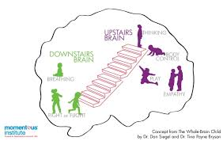
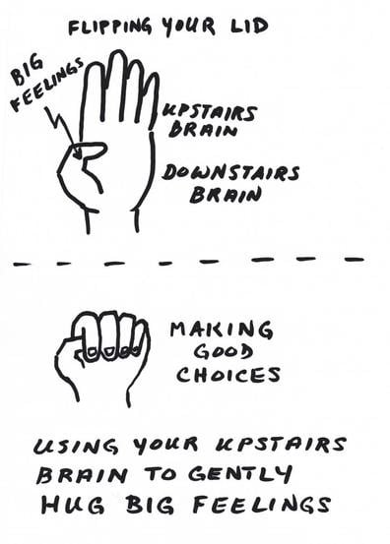
Stage 4 – Model of the brain – flipping your lid
Notes:
Lego model of house – watch emotion coaching website
Video – emotion coaching flip your lid- hand model of the brain emotioncoachinguk website
Downstairs brain – Emotional brain (limbic system and brain stem)
Upstairs brain – Thinking brain (cortext)
Can put your lid back on by breathing and spending time with someone you like

